Slide 1

Yueyuan He
04/10/2020
Notes:
Hello proferssor, I am Yueyuan he,
. So today I will talk about what can we do using deep learning for anti-virus.
Since the beginning of 2020, China has been suffering brand new coronavirus, covid-19. this virus spread very fast

Slide 2
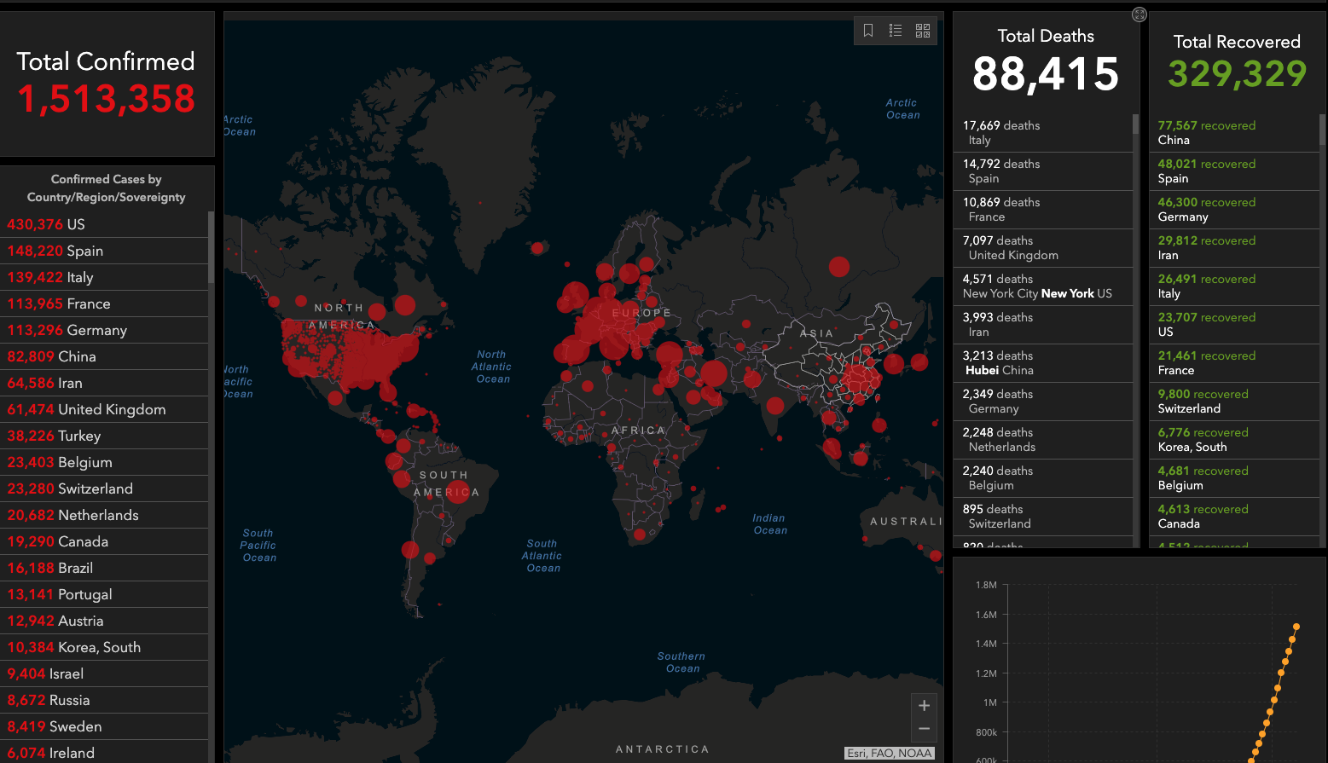
Notes:
By the time I gave this presentation, millions of people have confirmed the infection, and more than 430 thousand persons get confirm this virus in the United State, the state we live, New York state is the most terrible state in the US.

Slide 3

Why
Many ways to spread
Long incubation period
Not easy to detect
Notes:
Why does this virus affect people so much? According to my research there are mainly three reasons,
Especially not easy to detect.

Slide 4
Nucleic acid detection
Not enough test strips
High testing requirements
Low accuracy
Notes:
Early in the virus outbreak， Although China developed Nucleic acid test strip as fast as possible, there is not enough test strips for doctors to confirm patients. What’s more, this kind of test strip needs to be tested in advanced hospitals. The most serious is its accuracy is not high enough. So Chinese doctors use many ways to confirm, X-ray is one of them.

Slide 5
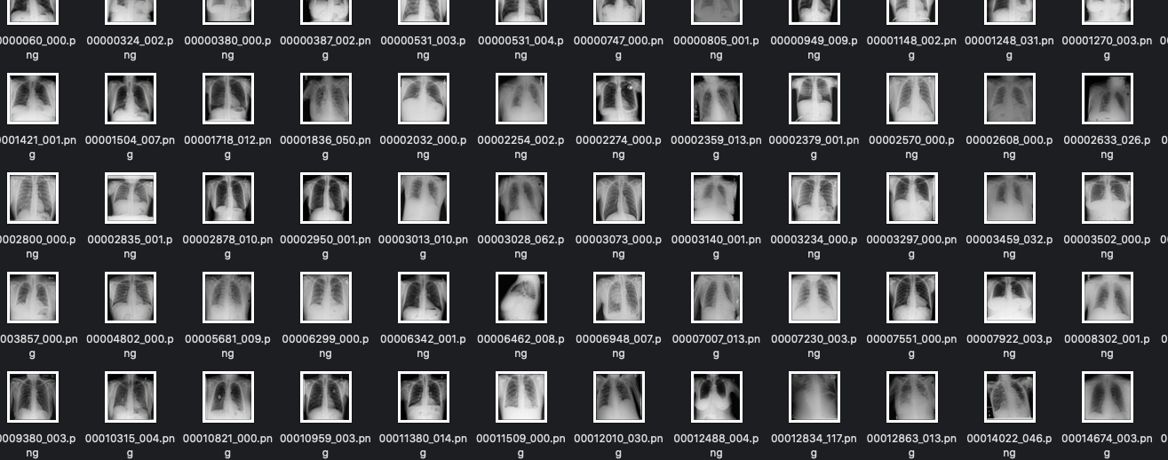
Notes:
But Due to virus outbreak， too many people are sick, so doctors can’t see a lot of X-ray in one day. Therefore, we can use Computer Vision to help doctors detect patient fast and accurately.

Slide 6
Problems
Not enough Public dataset
Less features in X-Ray
Not have Special Knowledge
Notes:
At first, I found there are some problems when detect a person get the virus whether or not,
However, After a period of hard work by all mankind, This idea to help identify x-ray has been verified

Slide 7
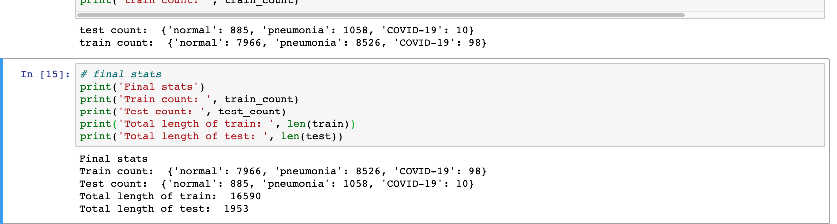
COVID-19 image data collection
https://github.com/ieee8023/covid-chestxray-dataset
Notes:
Now we have a big dataset on github, the total number of training is 16590, and the tnumber of training pictures that are Coronavirus is 98,

Slide 8
Solutions
Transfer Learning
VGGNet-16
DenseNet
ResNet
Data Augmentation
Size
Angle
albumentations
Notes:
Many people provide some solutions, one is to use transfer learning, such as ,,,,,
In meanwhile, strengthen data by expanding size or rotating angle of X-ray,
And
Albumentations 更强大，语义分割,更好分离 is one of the best data augmentation in Computer vision.
However, these model don’t perform very well.

Slide 9

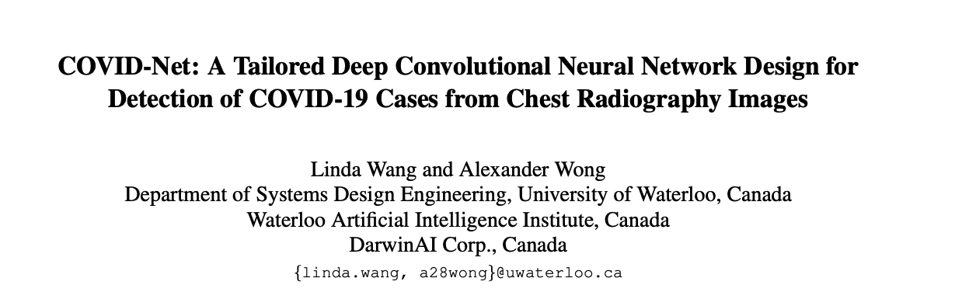
New Neural Network
https://arxiv.org/pdf/2003.09871.pdf
Notes:
Therefore, some specialists provided a new neural network for detecting coronavirus in recently.

Slide 10
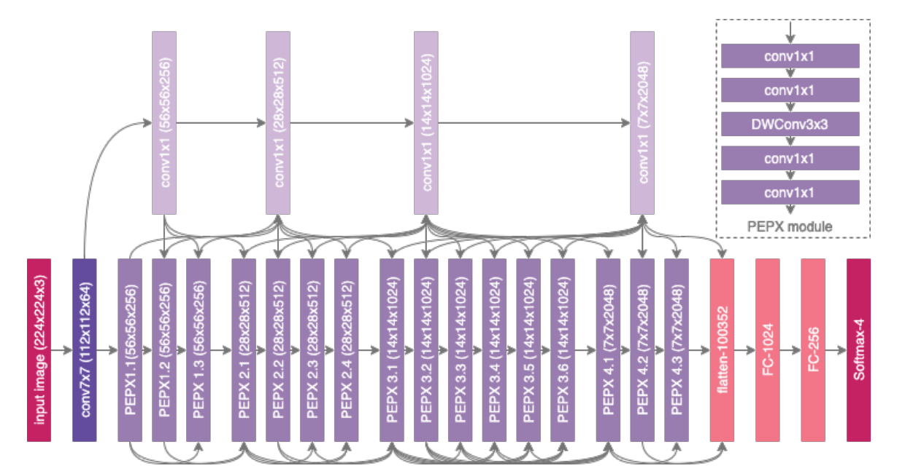
COVID-Net
Notes:
91 CNN, flatten layer, 2 FC layer, and the last layer is classified by softmax
It can be observed that the COVID-Net network architecture makes heavy use of a lightweight residual projection expansion-projection-extension (PEPX) design pattern
Furthermore, it can be observed that there is considerable architectural diversity and selective long-range connectivity in the COVID-Net architecture

Slide 11
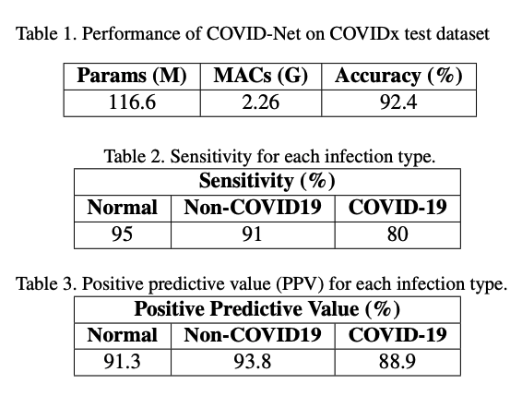
Validation
Notes:
The performance of this COVID-Net is pretty good for now, The accuracy rate reached 92.4 from this paper.

Slide 12

Conclusion
Significant effect
Still need to improve
Inevitable development trend
Notes:
Therefore, we can see detecting coronavirus by Deep Learning can improve efficiency of testing, it can help doctors save lives,
Thereby it can reduce the spread
But this idea still need to be more verified. Because Now we don’t have too many X-ray pictures which are COVID-19 because of the privacy of patients, second, Building this deep neural network needs a great deal of calculation by GPU,
However, we still can count on deep learning to help us solve problems like this, after all, it is inevitable development trend,
At last, I hope we can return our normal tracks as soon as possible. Thank you.

Slide 13
Reference
COVID-Net: A Tailored Deep Convolutional Neural Network Design for Detection of COVID-19 Cases from Chest Radiography Images
https://arxiv.org/pdf/2003.09871.pdf
COVID-CT-Dataset: A CT Scan Dataset about COVID-19
https://arxiv.org/pdf/2003.13865.pdf

